Slide 1
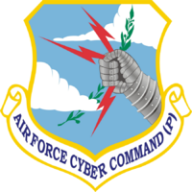
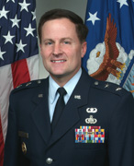
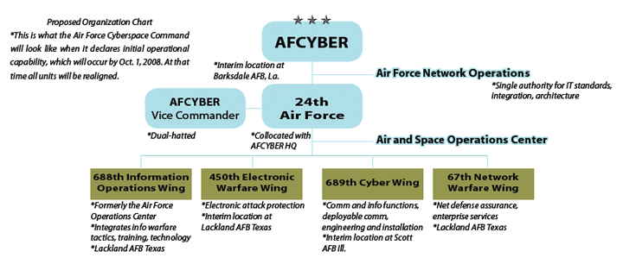
History Highlight
Feb 2006~ HQ USAF released a vision statement calling for the creation of a cyber com­mand to protect the nation from an “electronic Pearl Harbor.”
AFCYBER was stood up as a provisional MAJCOM from 2007-2008, intending IOC by 1 Oct 08.
This never came to be.
Per the PPlan, the Air Force Communications Agency was to be redesignated 24th Air Force
Maj Gen William Lord, AFCYBER (P)’s
first (and only) CC
Scott AFB was one of six
installations competing to house the new MAJCOM/NAF.
AFCYBER as a MAJCOM never activated, the mission was assigned to the newly created 24th AF (18 Aug 2009) with Lackland AFB selected as its HQ.
Notes:
Captions (clockwise):
Air Force Cyberspace Command (P) unofficial emblem
1 Oct 08 AFCYBER Command proposed structure
Maj Gen William Lord, Commander, AFCYBER Command (P)
--------------------------------------------------------------------------------------
Lt Gen Lord retired as the AF CIO in Aug 2012
Per the PPlan intent was to activate then redesignate the former Strategic Air Command & AFCA was to redesignate to 24th Air Force
Peterson, Scott, Barksdale, Offutt, Lackland, and Langley (competed for AFCYBER home)
Assigned
-24th AF
-67th Network Warfare Wing (Cyberspace Wing)
-688th Information Operations Wing (Cyberspace Wing)
-450th Electronic Warfare Wing
-689th Combat Communications Wing

